Slide 1
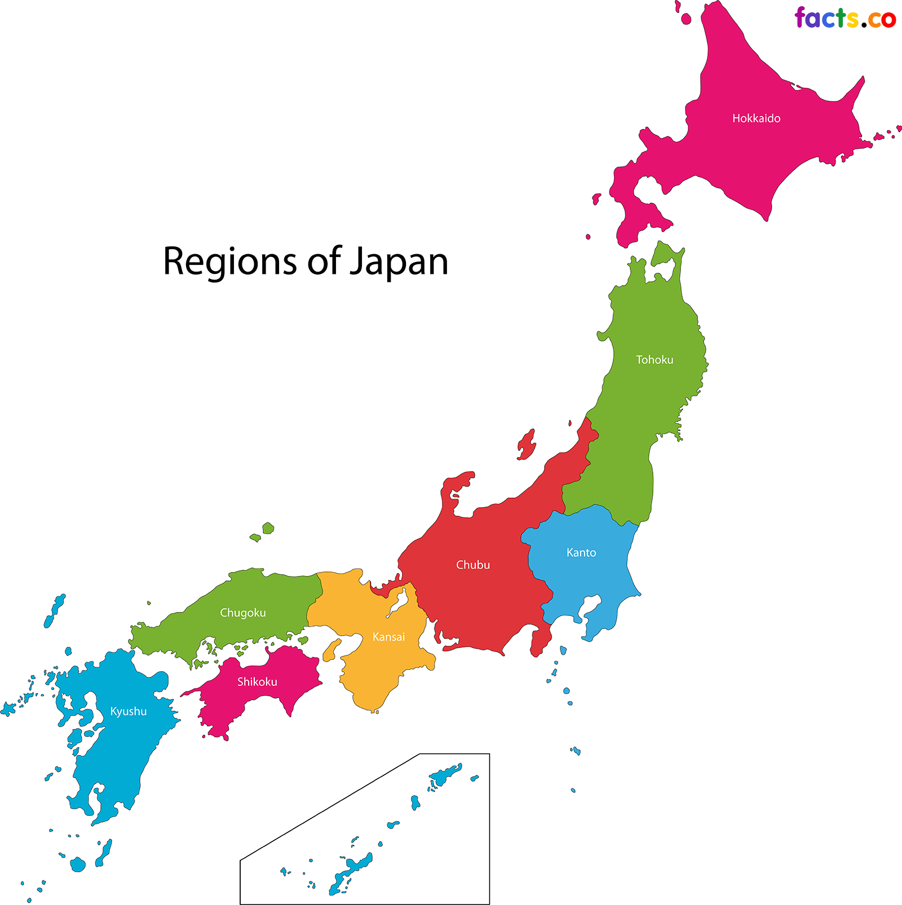
Human and Physical Features
Big Map of Crow Boy’s Land

Slide 2
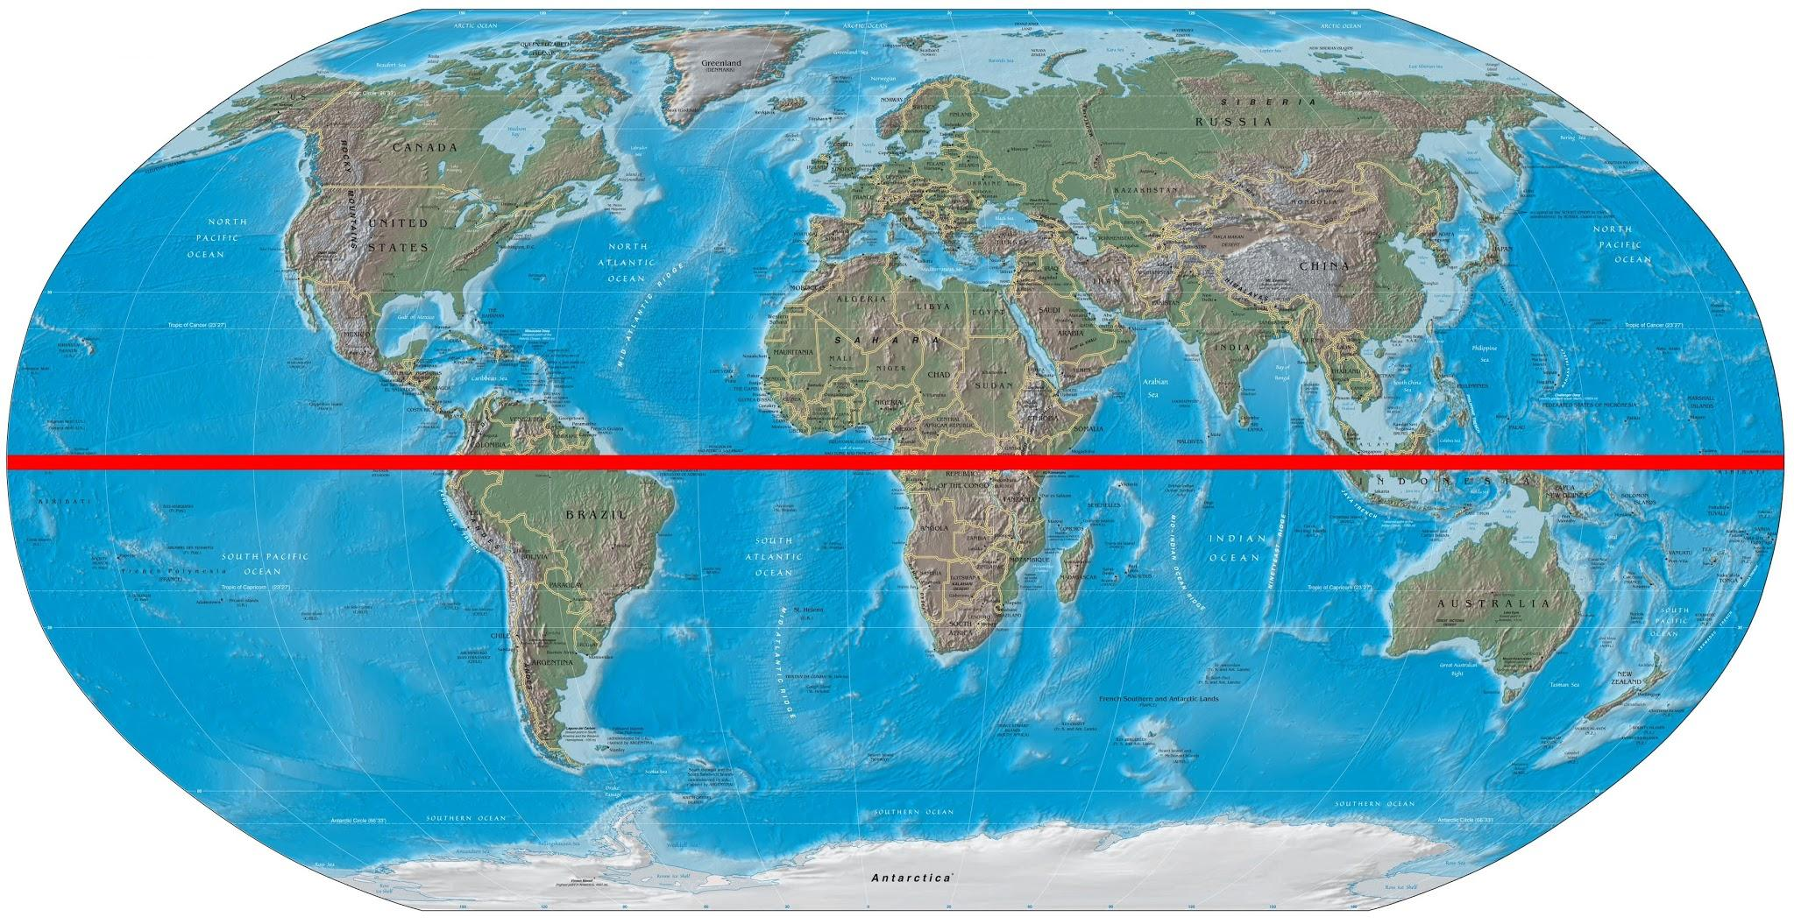
Equator
The equator is an imaginary line on the surface of Earth equal distance from its poles. It divides the Earth into Northern and Southern Hemispheres.

Slide 3
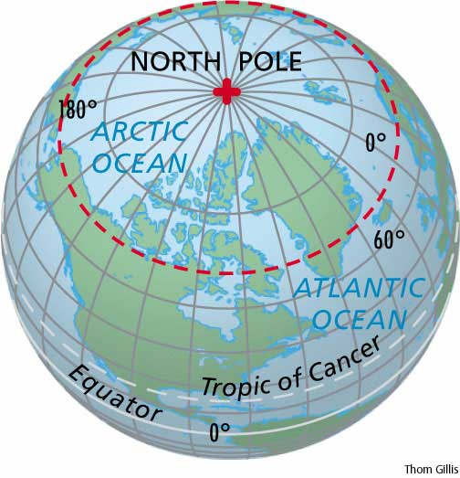
North Pole
The location of the North Pole is in the Arctic Ocean. There is no land at the North Pole. It is ice and water.

Slide 4
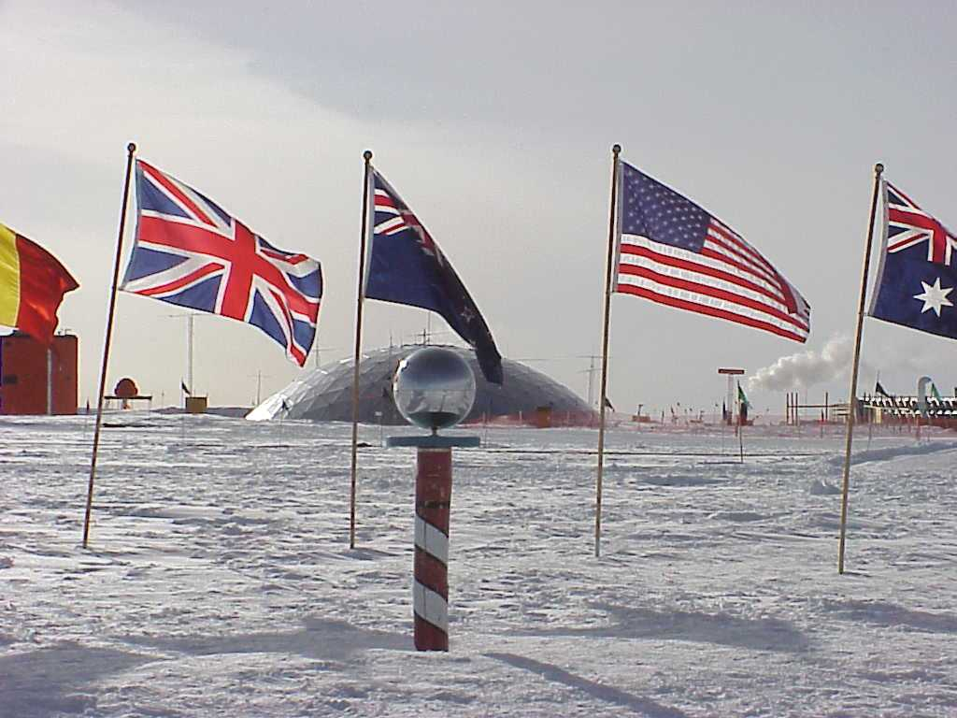
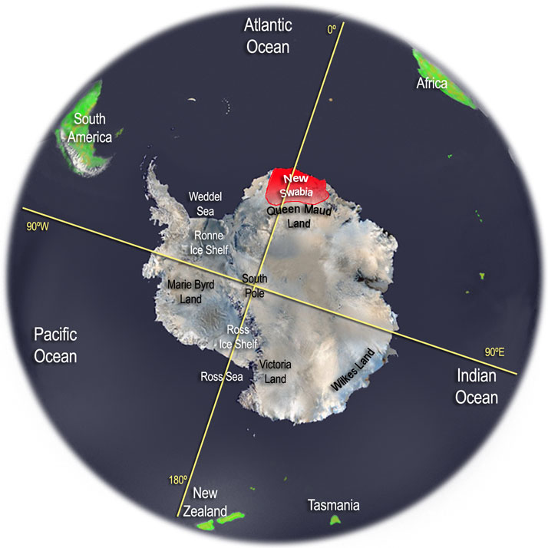
South Pole
The South Pole is the most southern point on Earth. It is located on solid ground. This fact allows scientists to build and live at a research station located there.

Slide 5
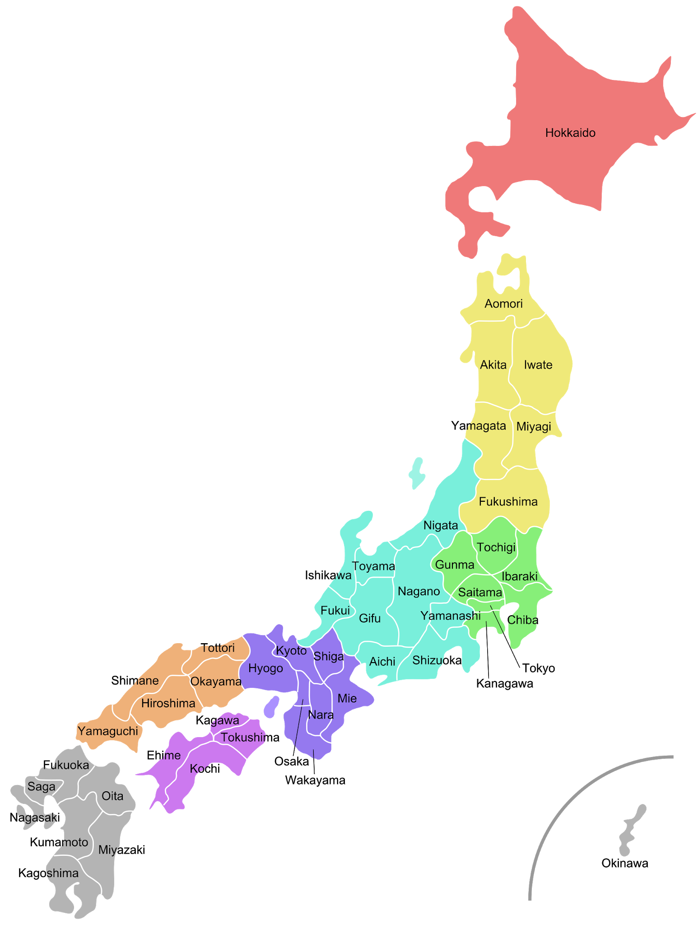
Japan
Japan is an island nation in the Pacific Ocean with many people living in large cities. It also has imperial palaces, mountainous national parks, and thousands of shrines and temples.

Slide 6
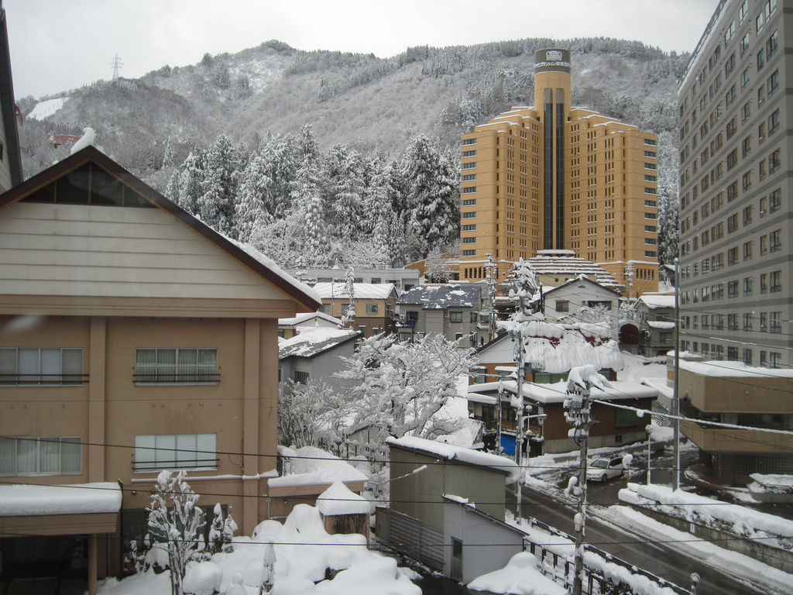
Echigo Mountains
Echigo Mountains is a mountain range. Large amounts of snow fall in this region because of the wind blowing from Siberia.

Slide 7
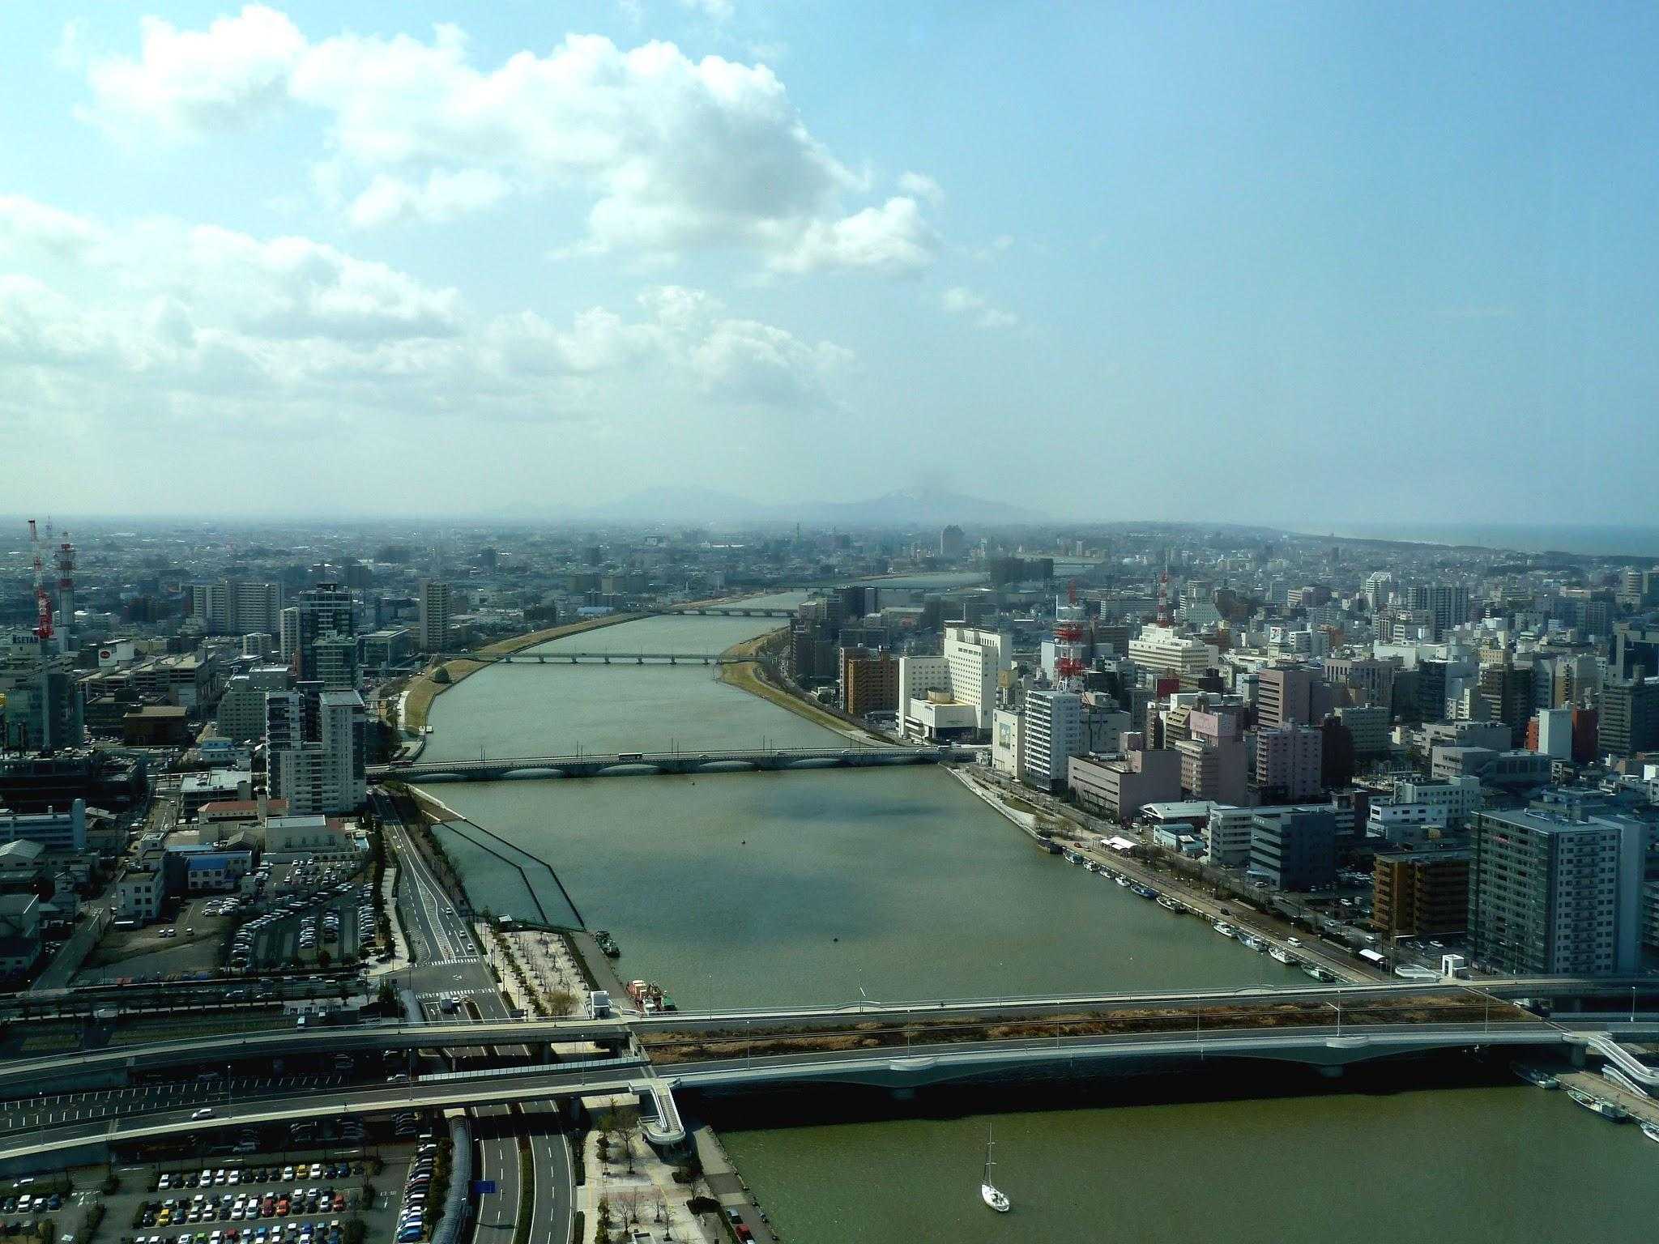
Shinano River
The Shinano River is the longest and widest river in Japan.

Slide 8
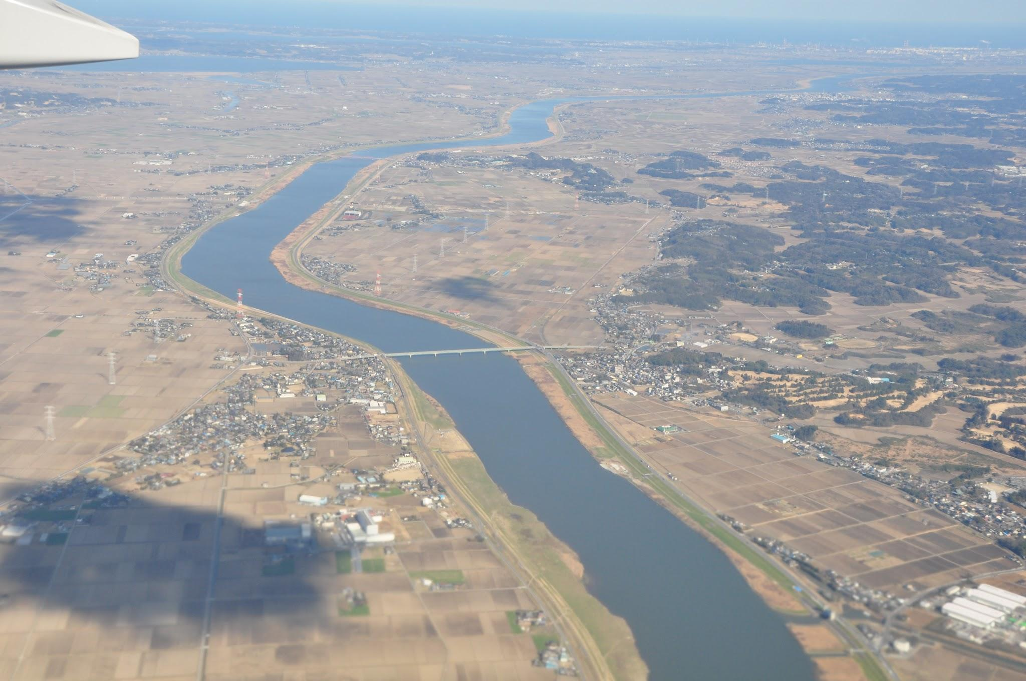
Tone River
The Tone River is a river in the Kanto region and is one of the three largest rivers in Japan.

Slide 9
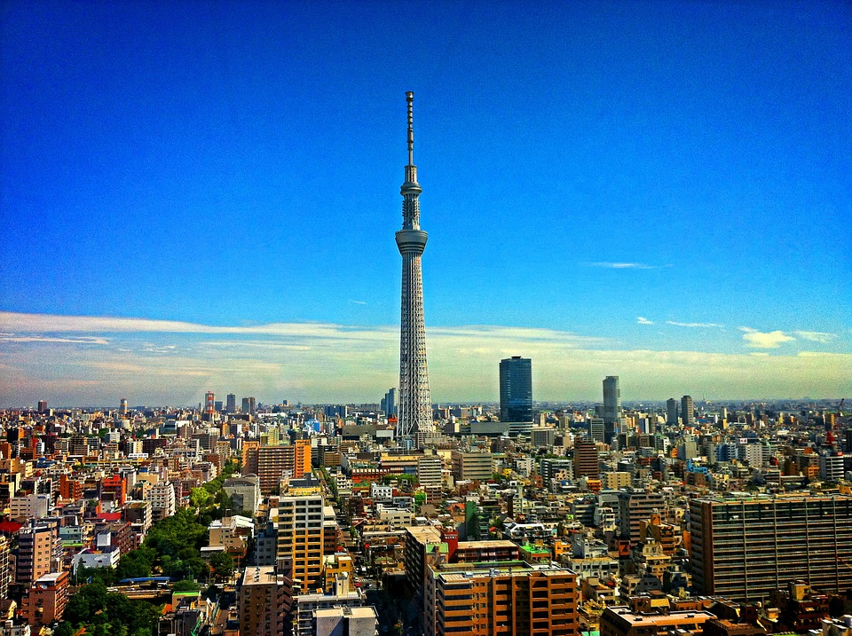
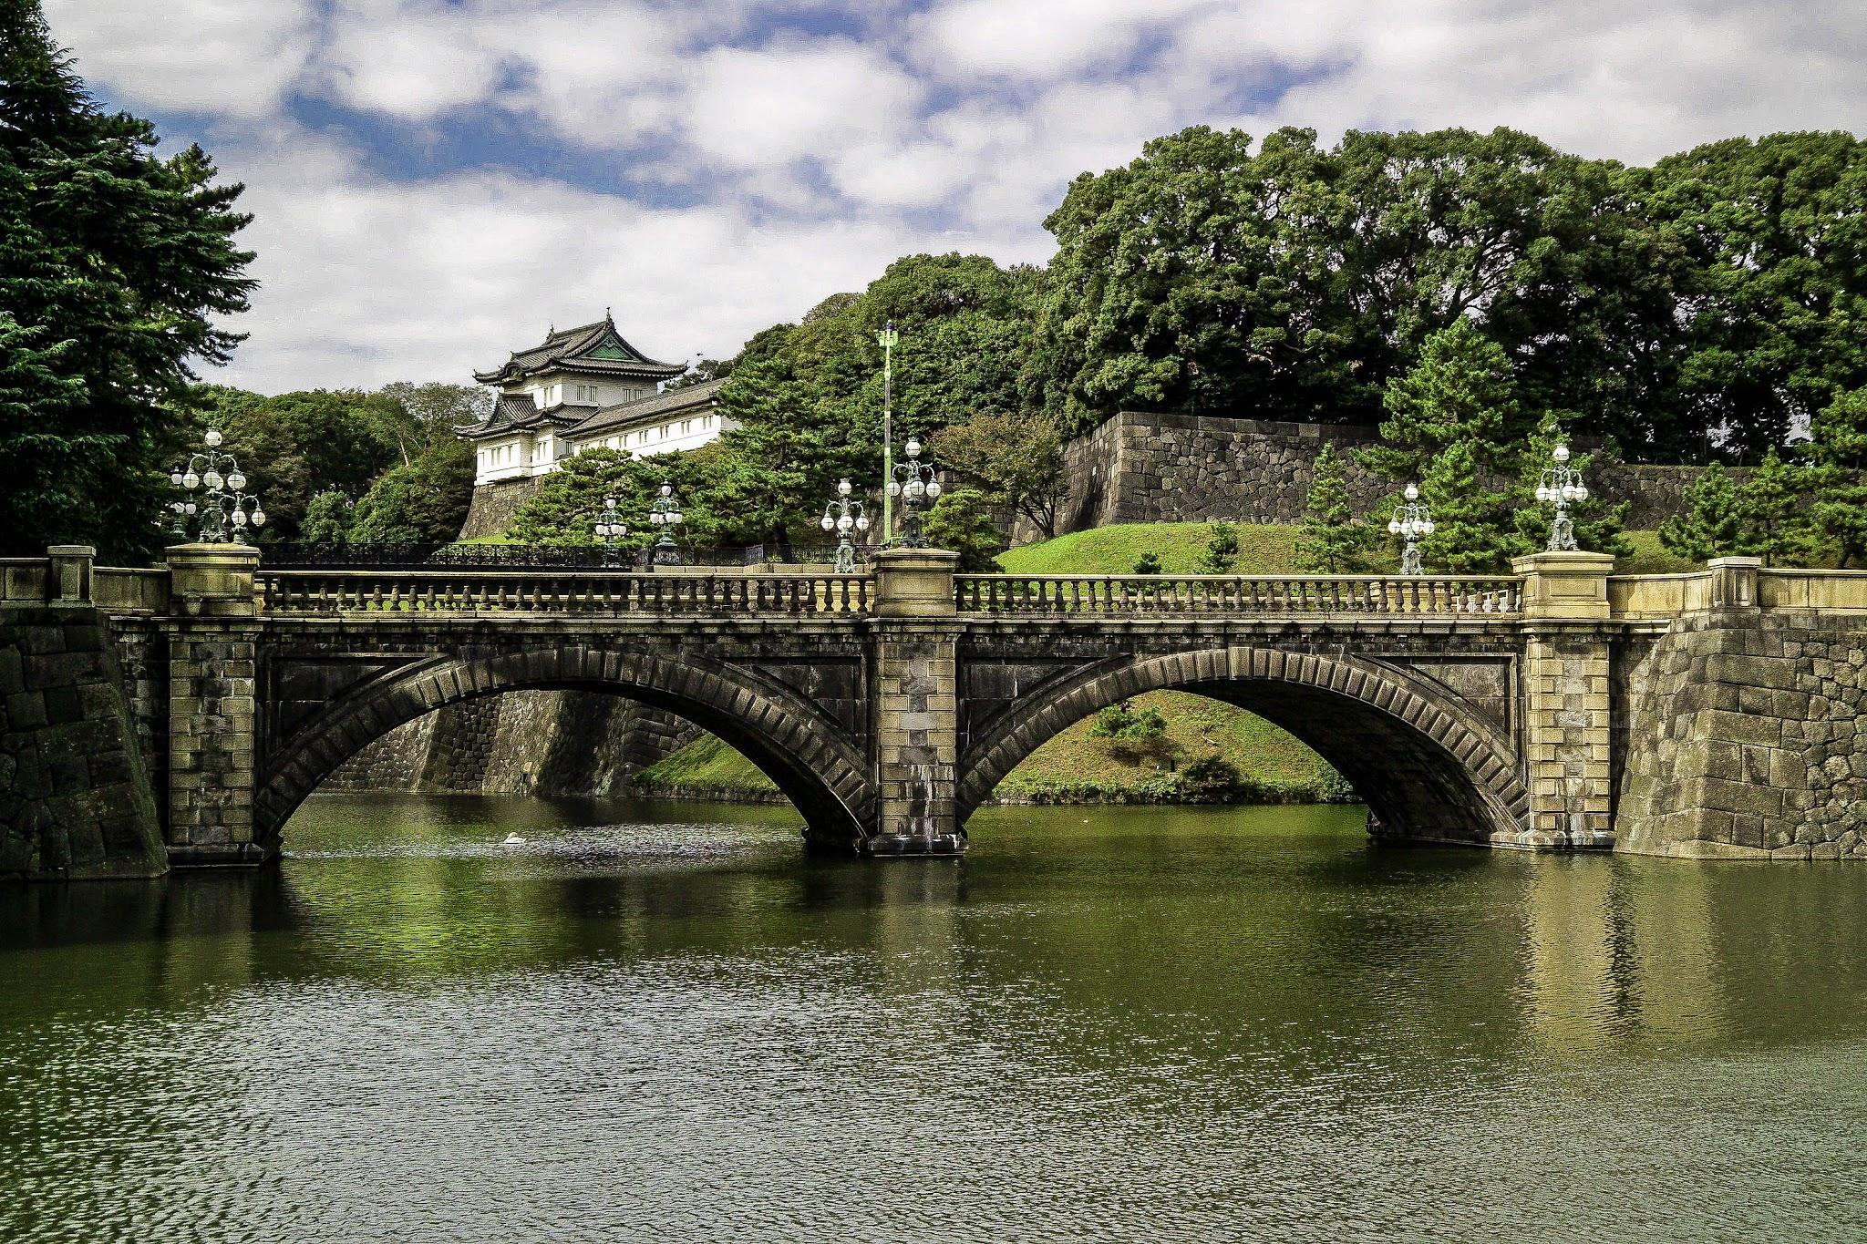
Tokyo
Tokyo is the capital of Japan. It mixes modern skyscrapers and historic temples. The imperial palace sits in a large public garden.

Slide 10
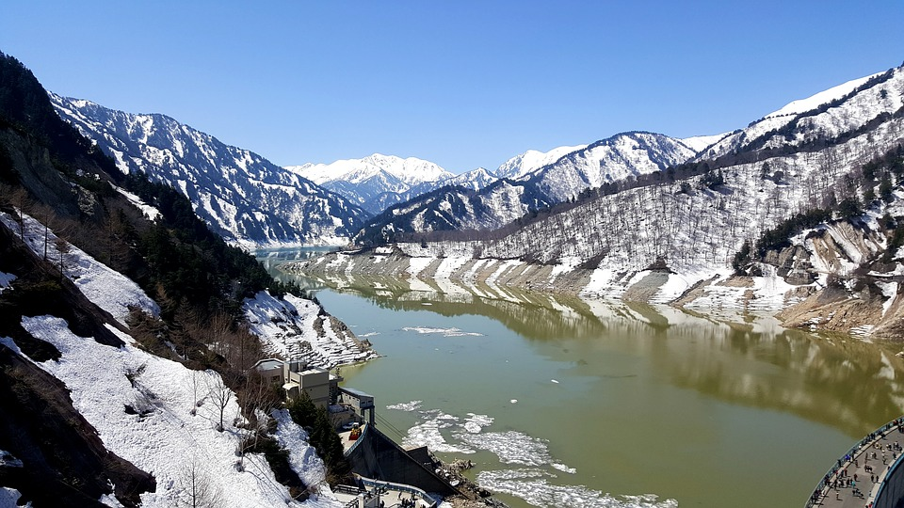
Japanese Alps
The Japanese Alps are a series of mountain ranges that cross the main island of Honshu.

Slide 11
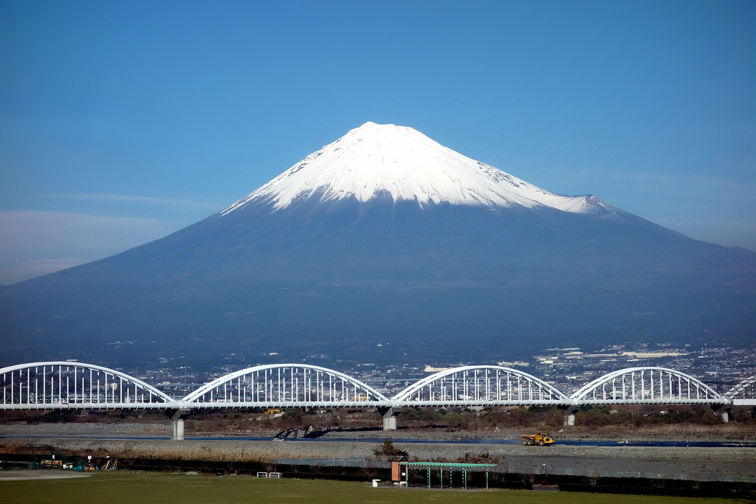
Mount Fuji
Mount Fuji is an active volcano about 100 kilometers or 60 miles southwest of Tokyo. It is commonly called “Fuji-san”.

Slide 12
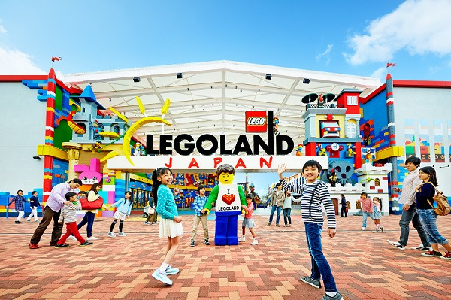
Nagoya
Nagoya is one of the largest cities in the world and has Legoland Japan.

Slide 13
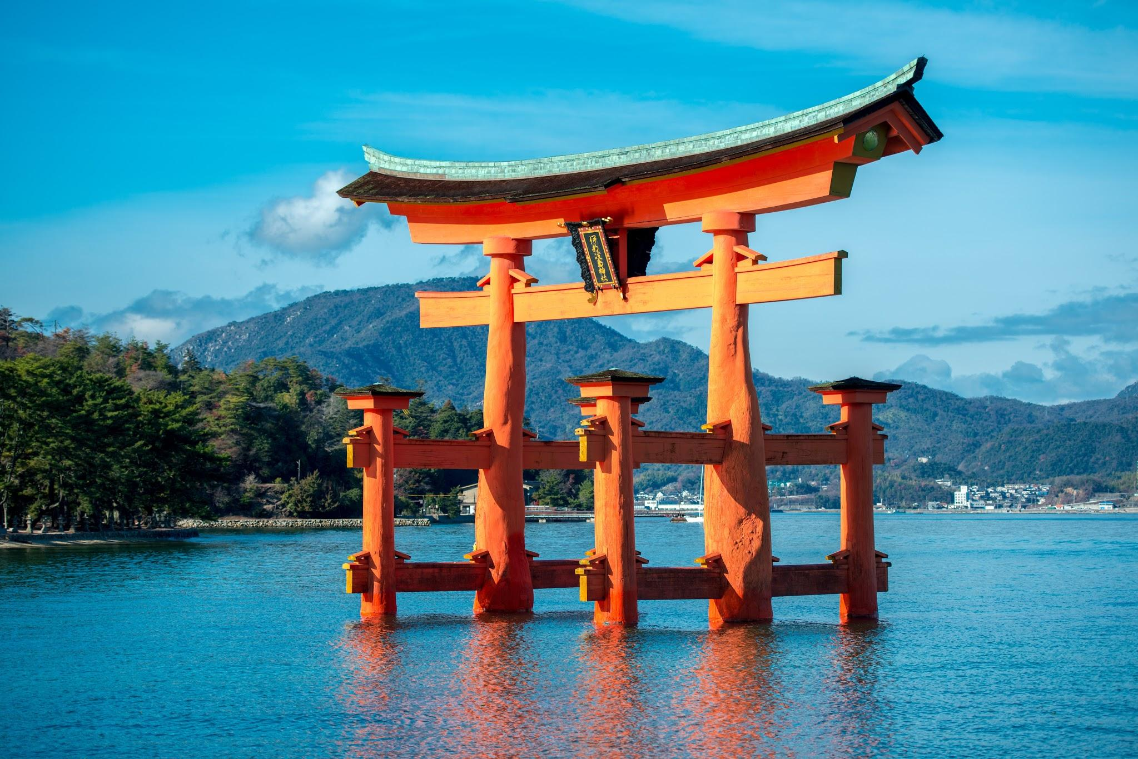
Lake Biwa
The Lake Biwa is a large body of fresh water northeast of Tokyo in the Shiga Prefecture.

Slide 14
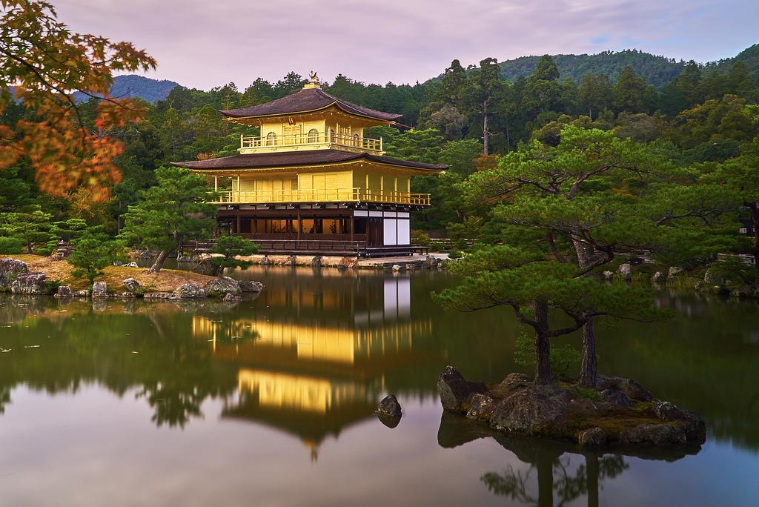
Kyoto
Kyoto is a city in the island of Honshu famous for the Kinkaku-ji gold colored temple.

Slide 15
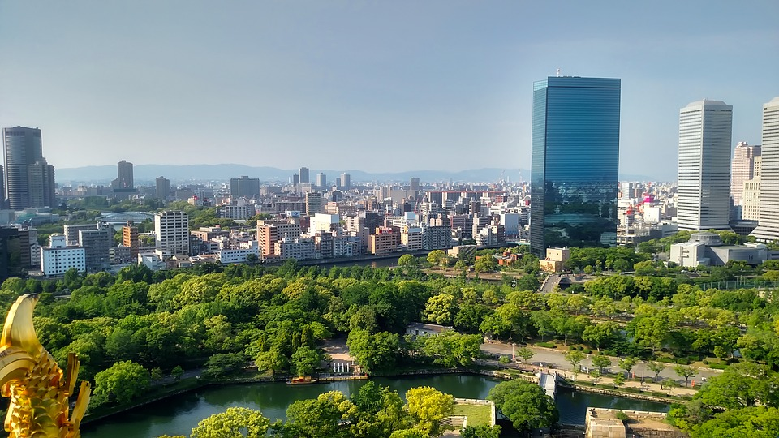
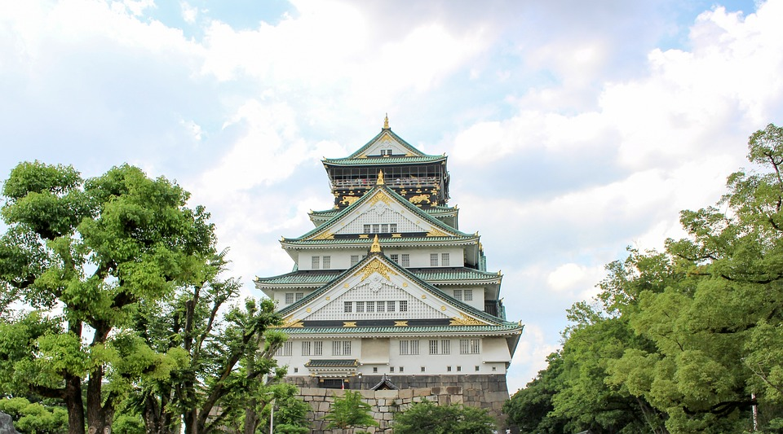
Osaka
Osaka is a large port city and commercial center on the island of Honshu. It is known for his modern architecture and a 16th century castle.

Slide 16
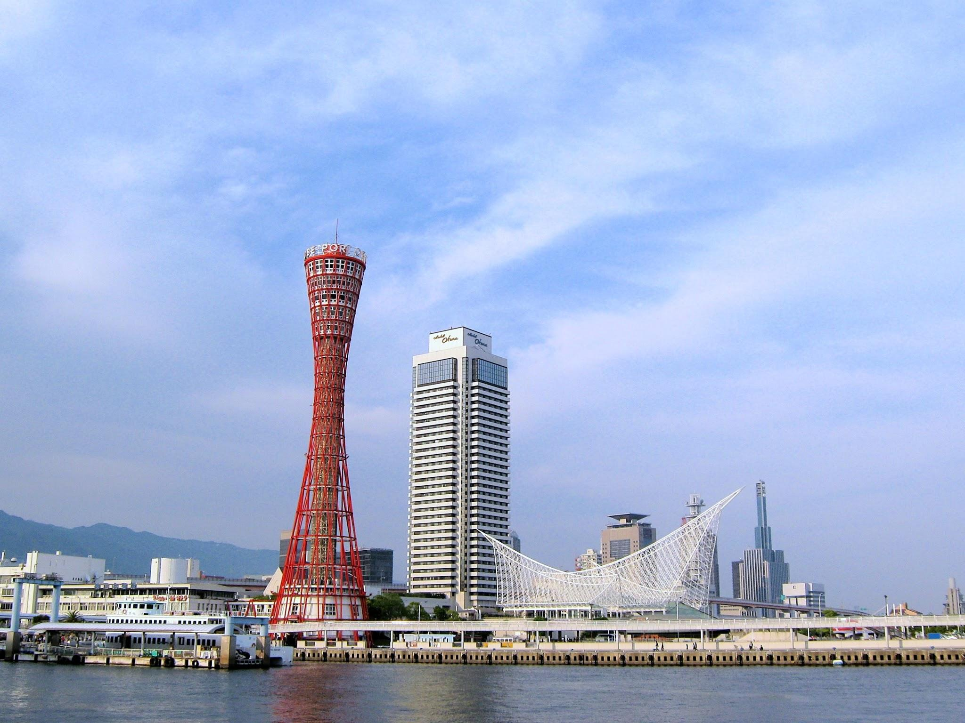
Kobe
Kobe is a city on Osaka Bay in central Japan. It is famous for its Kobe Port Tower.

Slide 17
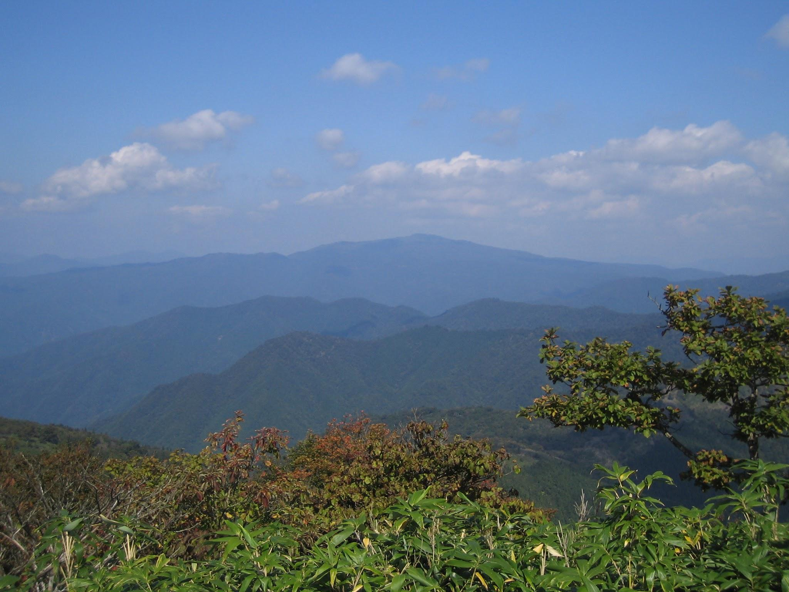
Chugoku Mountains
Chugoku Mountains is a mountain range in the Chugoku region of western Japan. Minerals from this area were used to make metal.

